Slide 1


Fedora linux
Group member: Danerson Teh 2370276-dcs
lai jun cheng 2370293-dcs
Phoon yew fai 2370265-dcs
wong weng hong 2390009-dcs

Slide 2
Today’s presentation:
SSH configuration
Firewall configuration
mySQL configuration
Git configuration

Slide 3

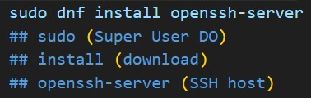
SSH configuration:
First step: Install ssh server

Slide 4
First step: Install ssh server

Slide 5
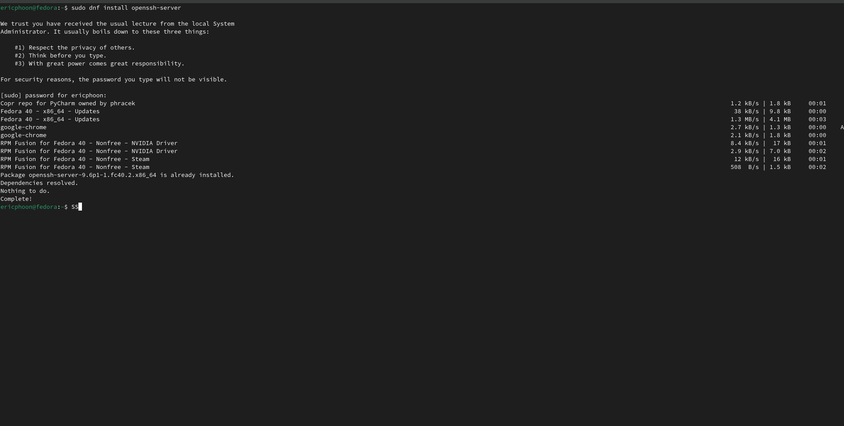
The result

Slide 6
Second step: enable ssh

Slide 7
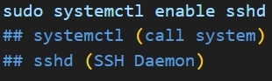
Second step: enable ssh
result:
DEDEDE!

Slide 8
result:
Second step: enable ssh
DEDEDE!

Slide 9
third step: start ssh and check status

Slide 10
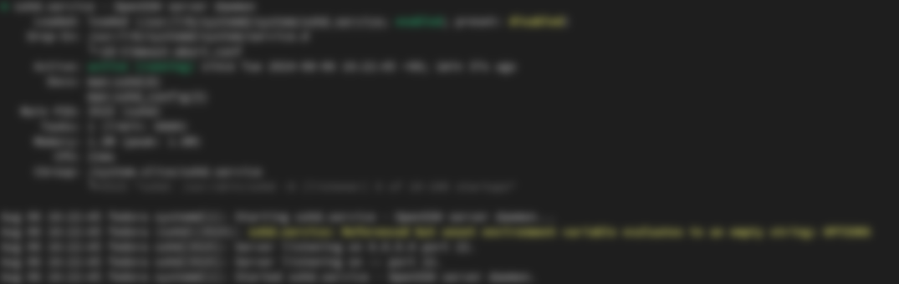
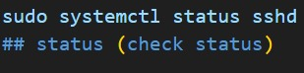
third step: start ssh and check status

Slide 11
third step: start ssh and check status

Slide 12
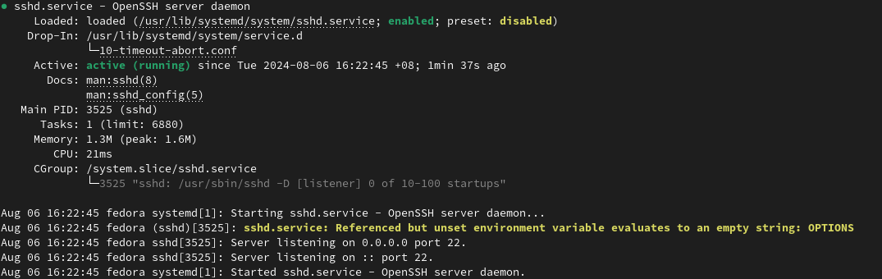
THE RESULT

Slide 13
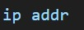
Forth step: Locate IP address

Slide 14

Forth step: Locate IP address

Slide 15
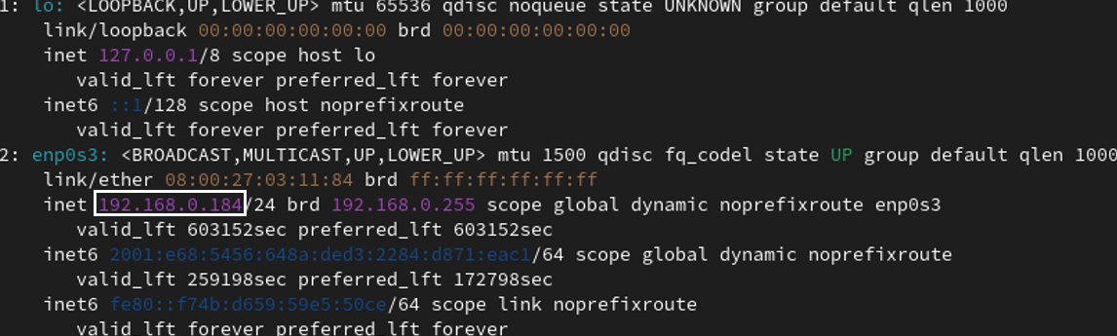
Forth step: Locate IP address
THE RESULT

Slide 16

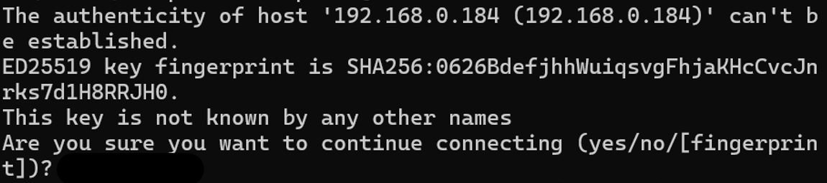

Slide 17
After obtained IP,
THE RESULT

Slide 18
Change to another host
THE RESULT

Slide 19
Code required:

Slide 20
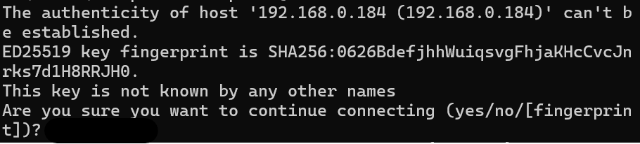
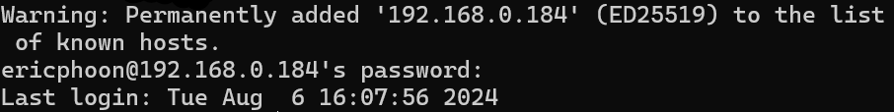
Press ‘Yes’

Slide 21
Press ‘Yes’
ENTER PASSWORD

Slide 22
After all steps done：

Slide 23
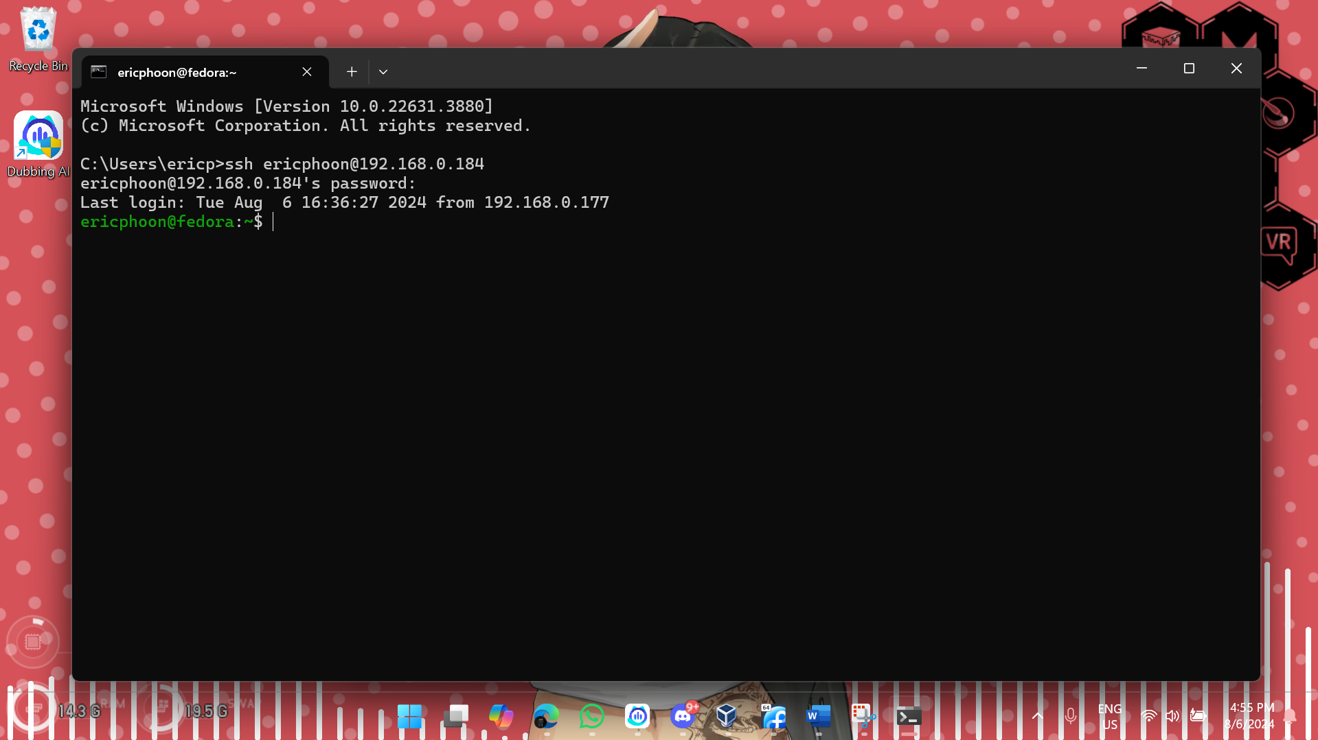
After all steps done：

Slide 24
Now, we can try some commands by remote host

Slide 25
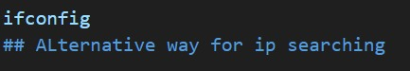
For example:
IP Checking

Slide 26
For example:
IP Checking

Slide 27
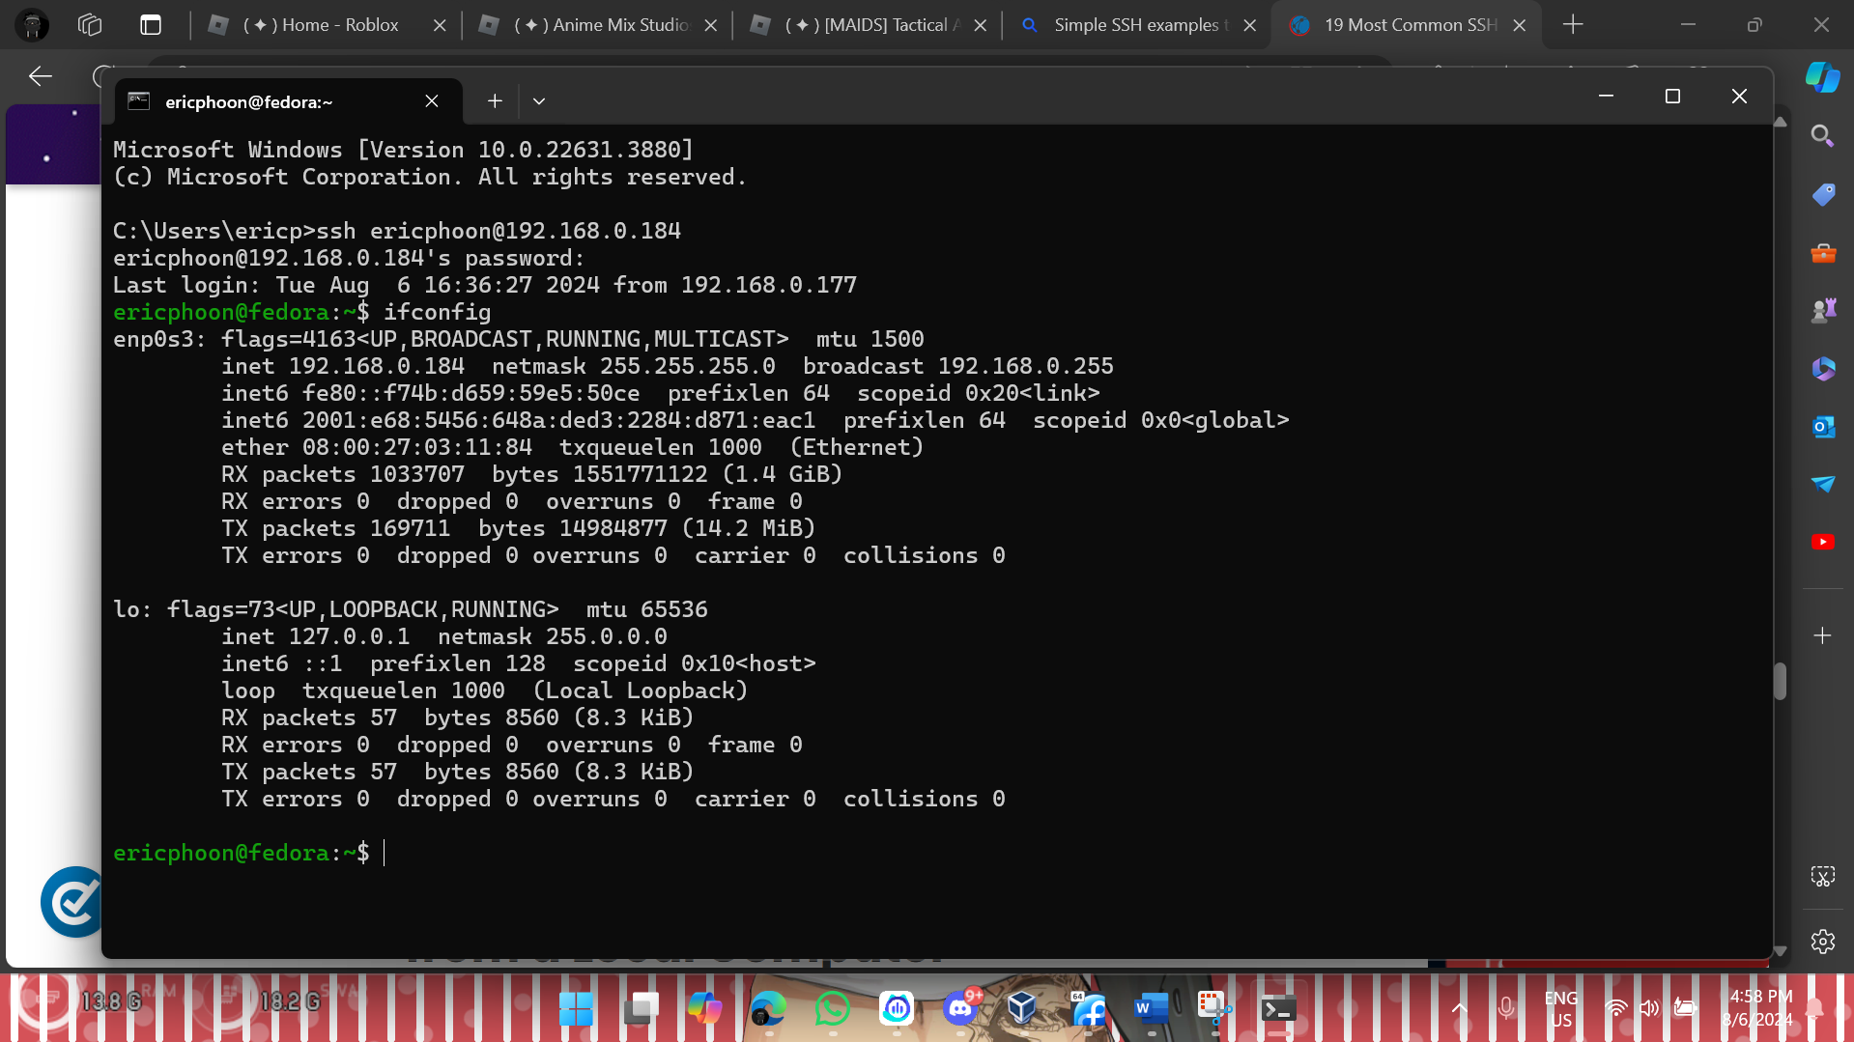

Slide 28
Update fedora linux

Slide 29
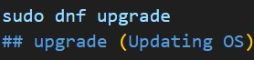
Update fedora linux

Slide 30

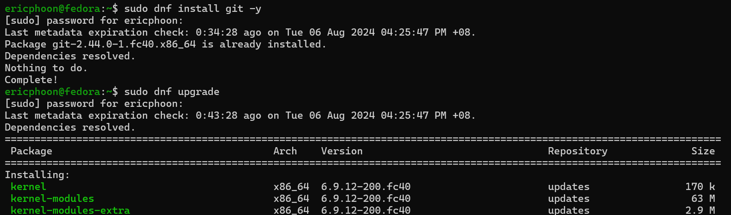
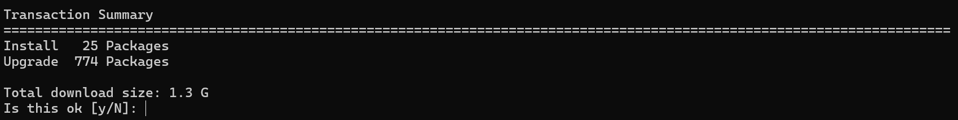

Slide 31


Slide 32
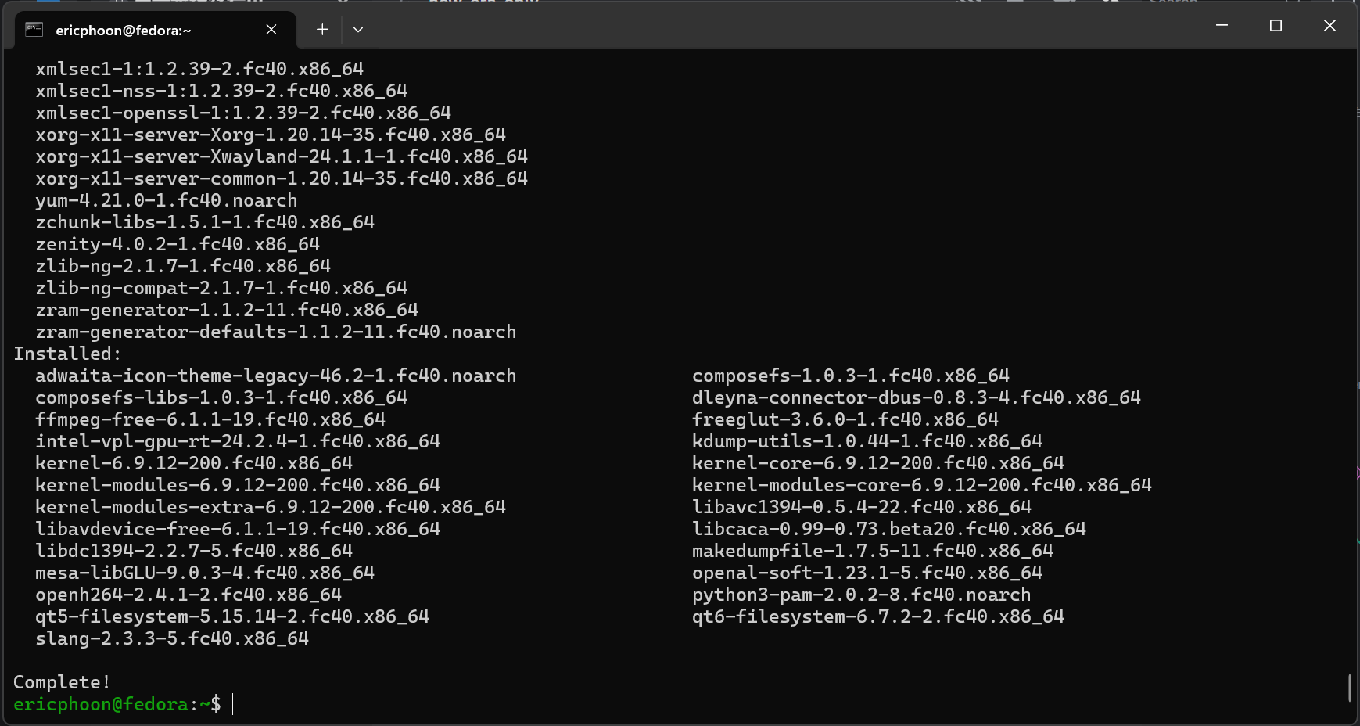

Slide 33
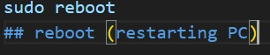
Or control the machine state
Reboot

Slide 34
Or control the machine state
Reboot

Slide 35
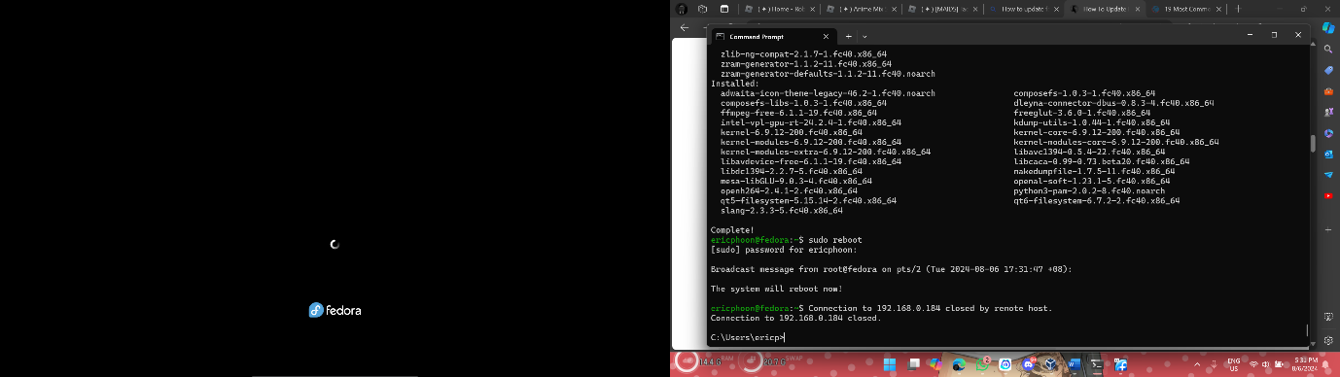
Or control the machine state
Reboot
Result:

Slide 36
Firewall configuration:

Slide 37
Firewall configuration:
Check firewall status
Terminate Firewall service
Restart Firewall
List available services
Add service
Remove service
Add new port
Remove port
Allow specified IP address
Reject specified IP address

Slide 38
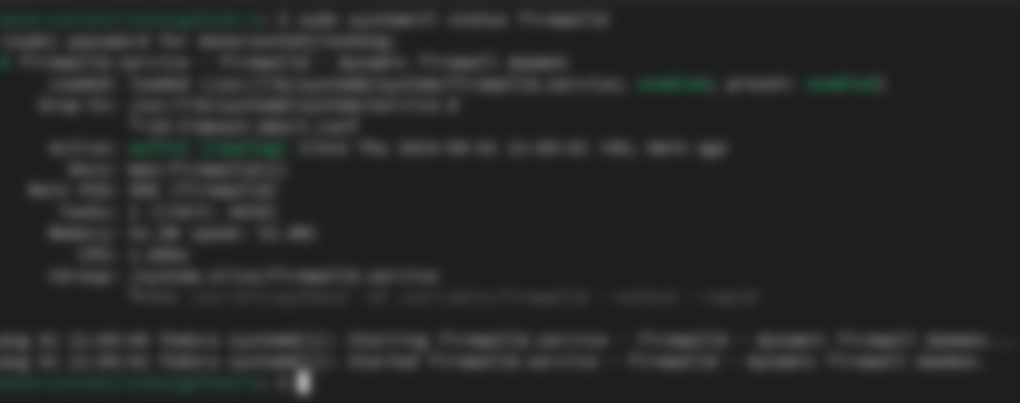
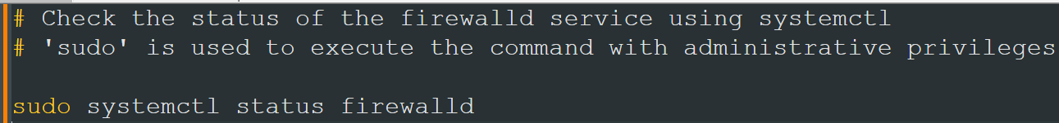
Check firewall status

Slide 39
Check firewall status

Slide 40
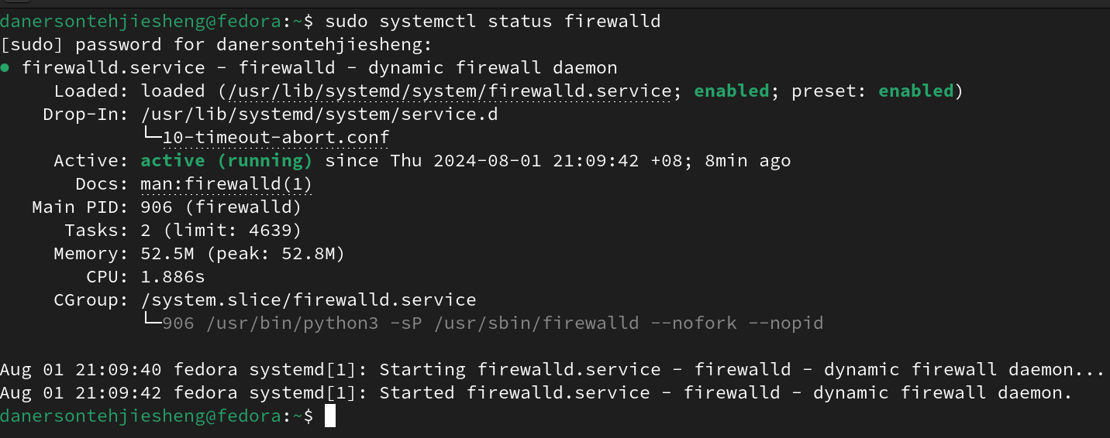
Check firewall status
Firewall state
result

Slide 41

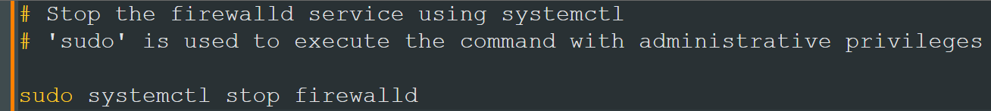
Terminate firewall service

Slide 42
Terminate firewall service

Slide 43
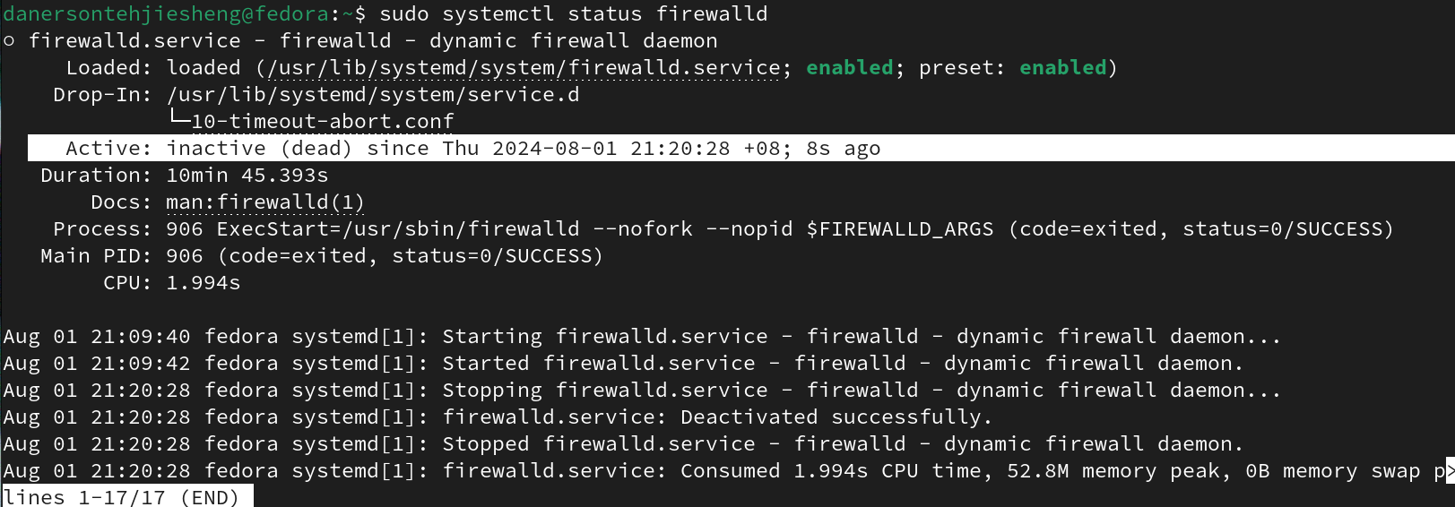
Terminate firewall service
Firewall is inactive
result

Slide 44

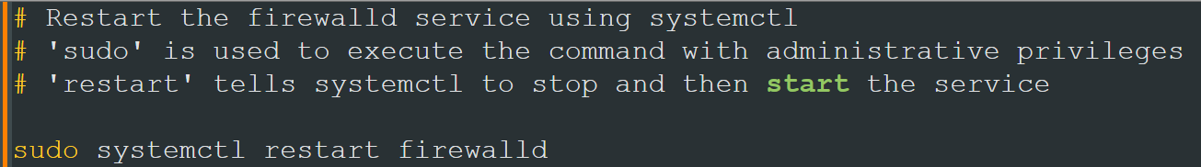
Restart firewall

Slide 45
Restart firewall

Slide 46
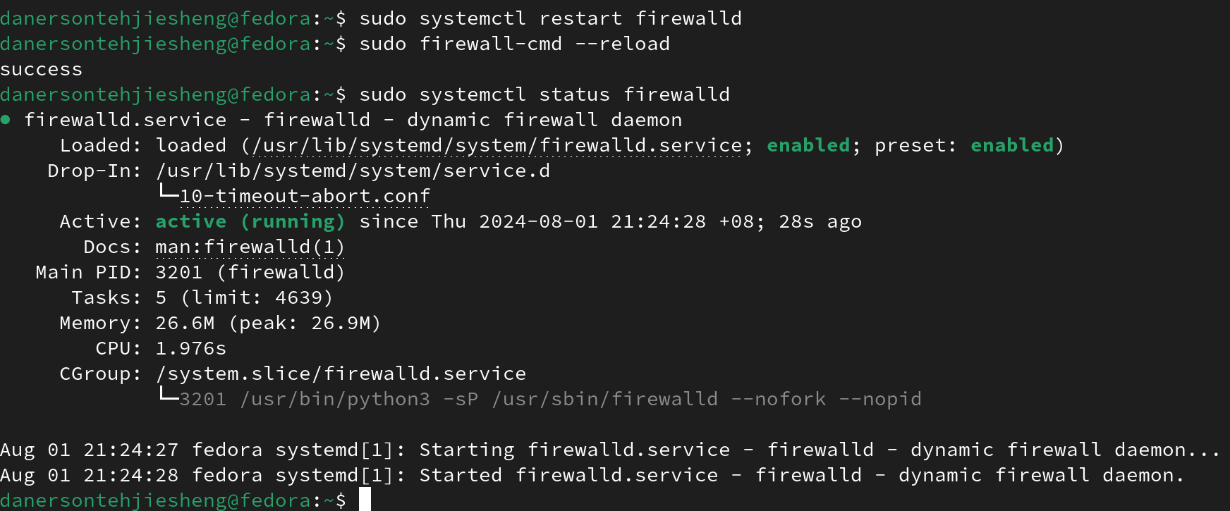
Restart firewall
result

Slide 47

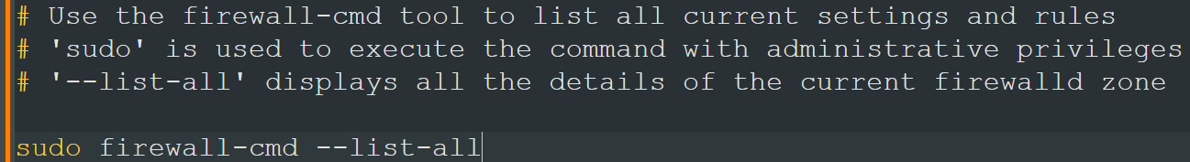
List available services

Slide 48
List available services

Slide 49
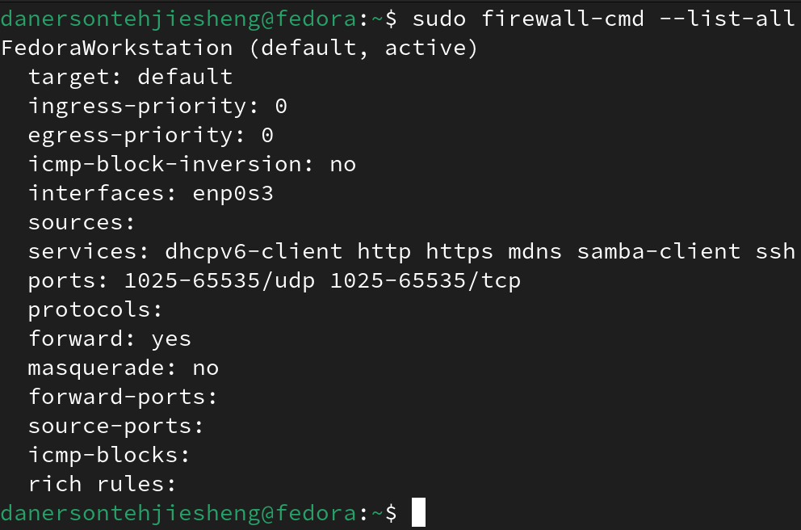
List all devices
Services
Available ports
Forward and source ports
Firewall rules
result

Slide 50

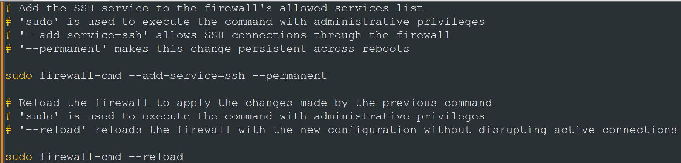
Add new service

Slide 51
Add new service

Slide 52
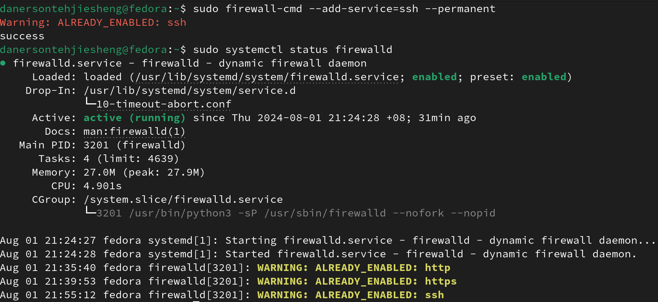
Add new service
enabled
result

Slide 53

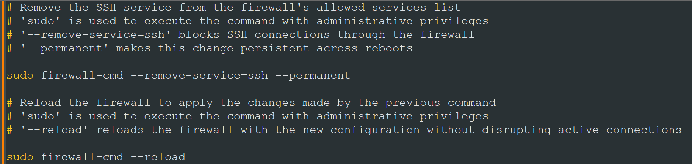
Remove service

Slide 54
Remove service

Slide 55
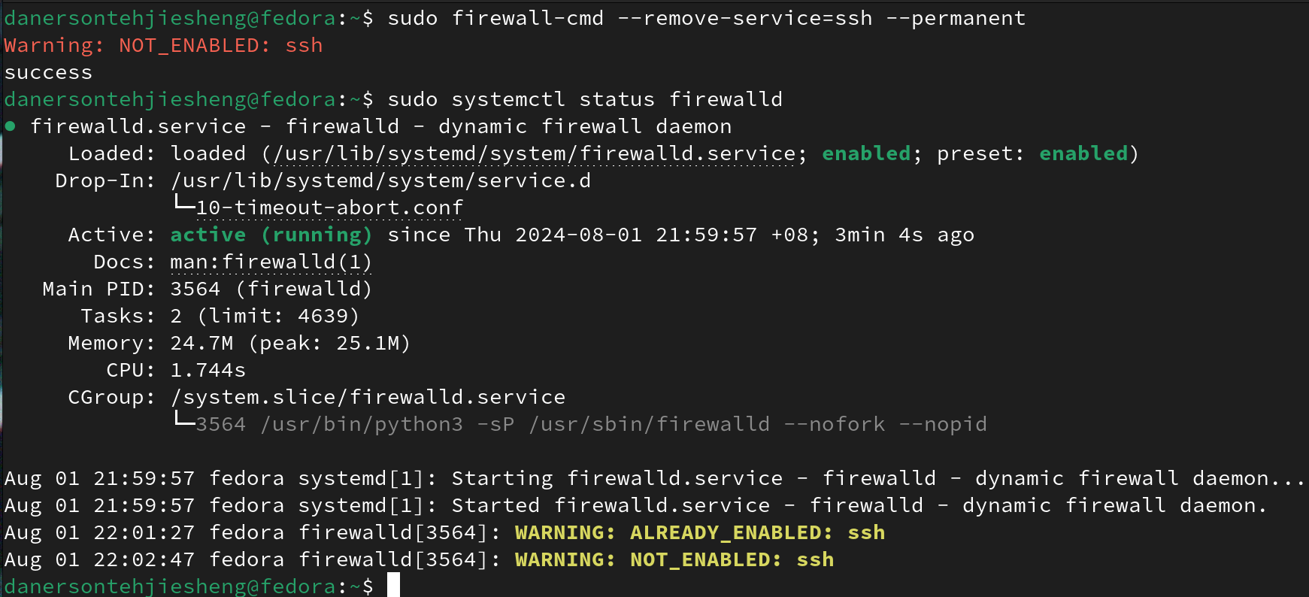
disabled
result
Remove service

Slide 56

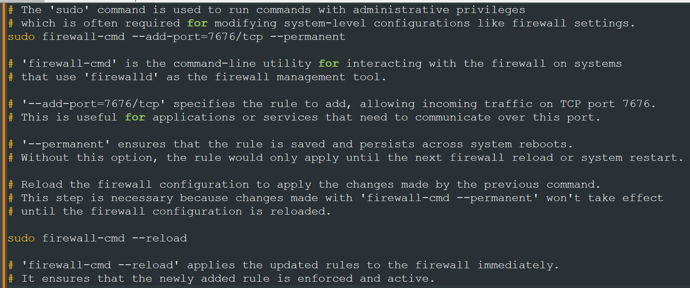
Add new port

Slide 57
Add new port

Slide 58
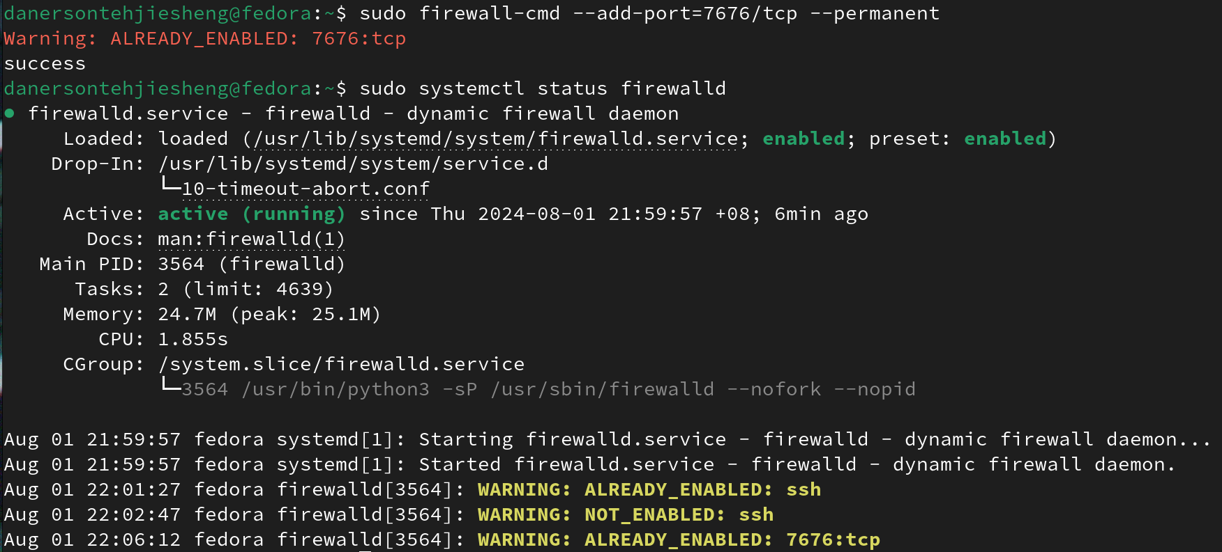
Add new port
enabled
result

Slide 59
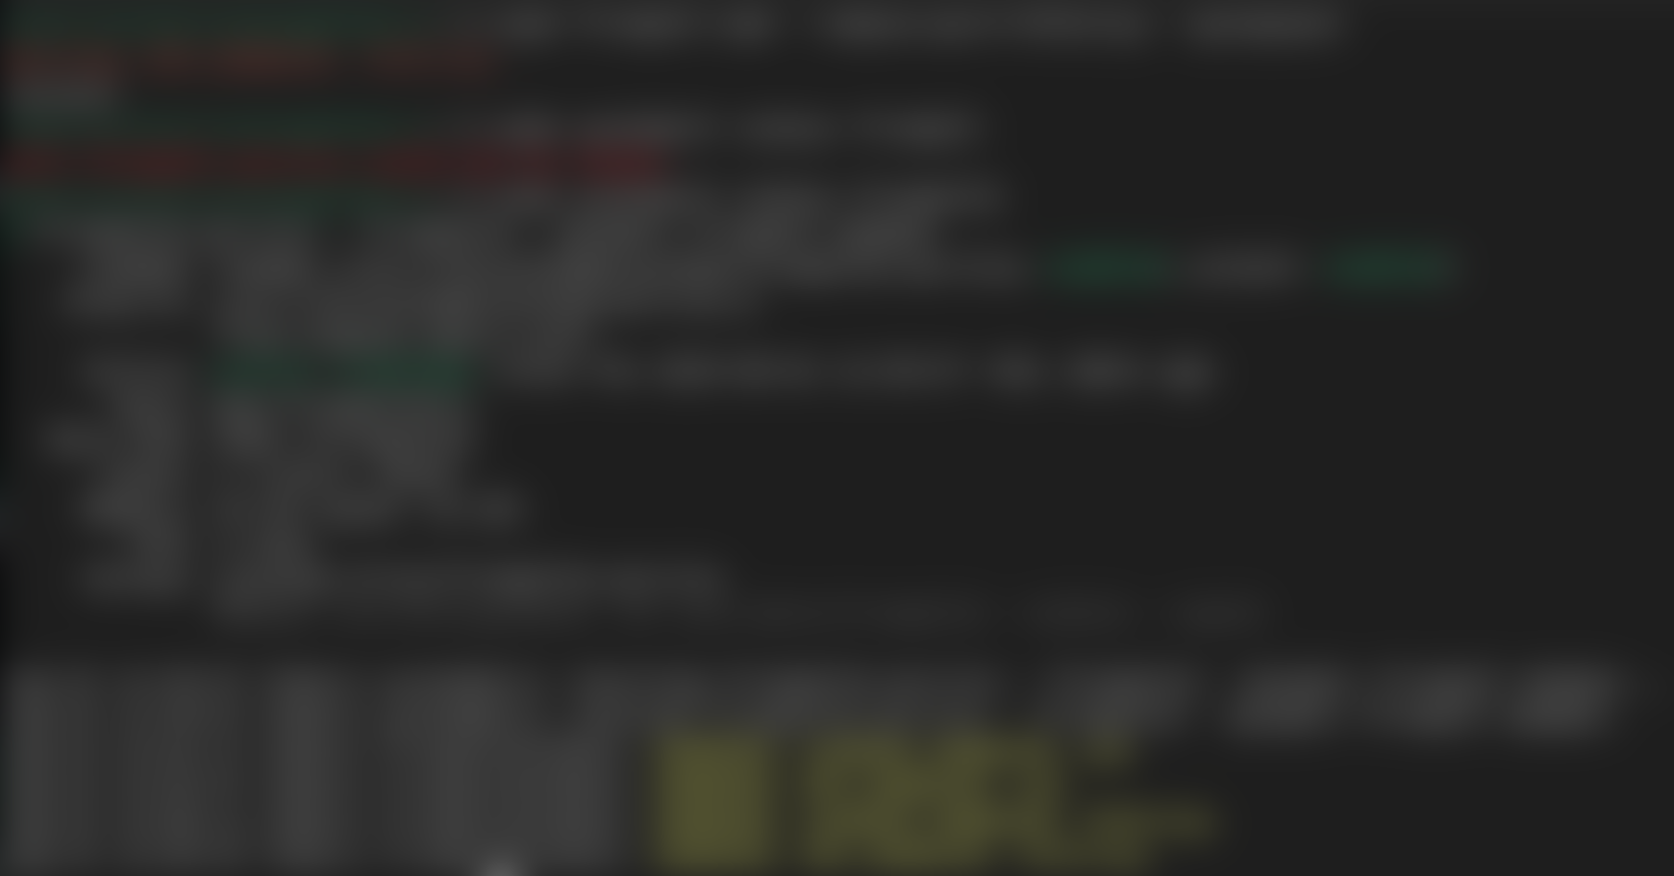
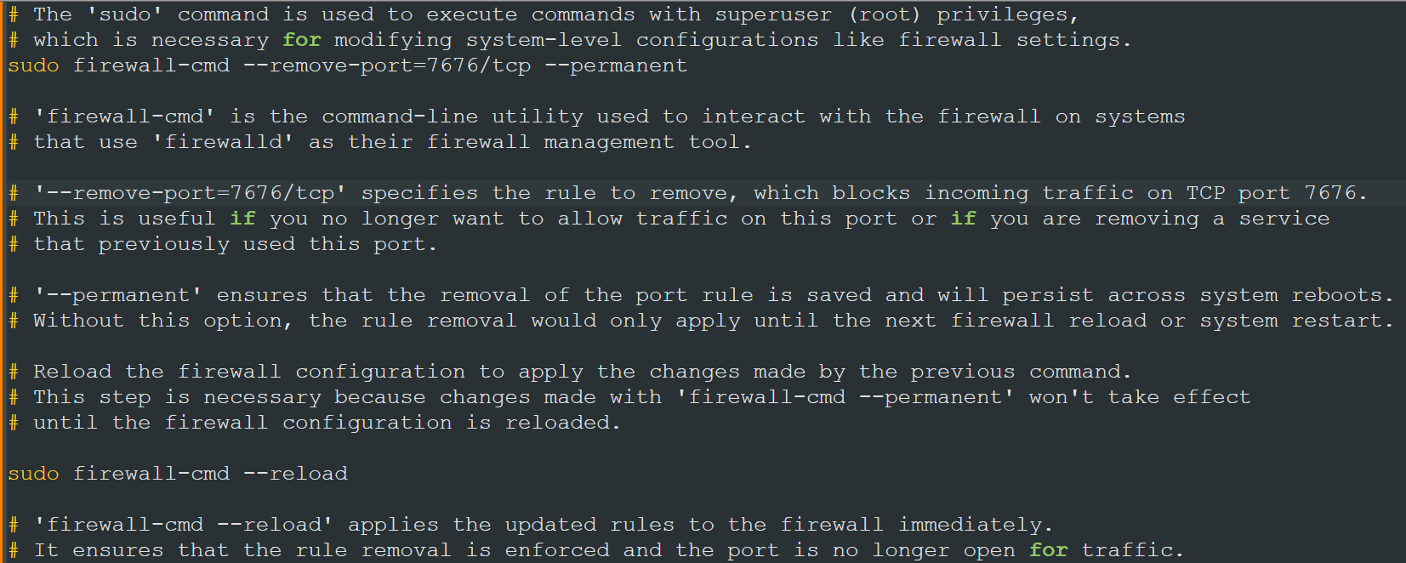
Remove added port

Slide 60
Remove added port

Slide 61
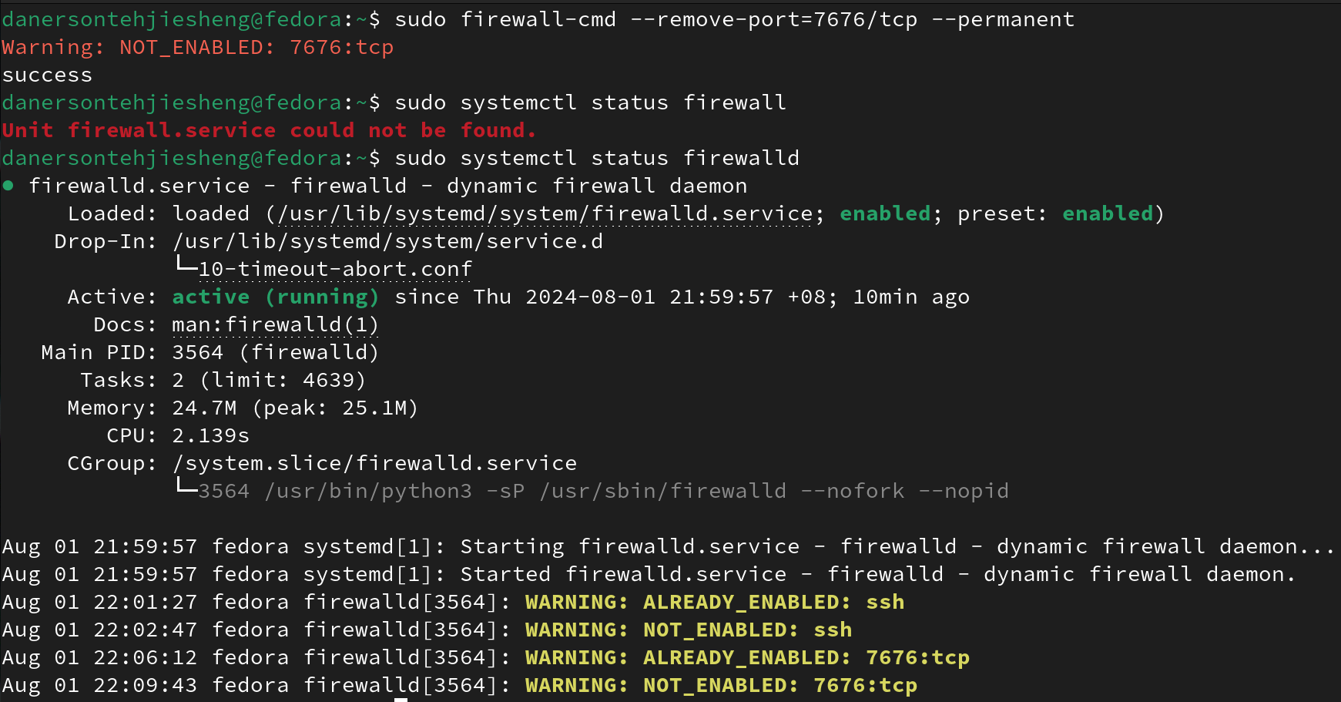
Remove added port
disabled
result

Slide 62

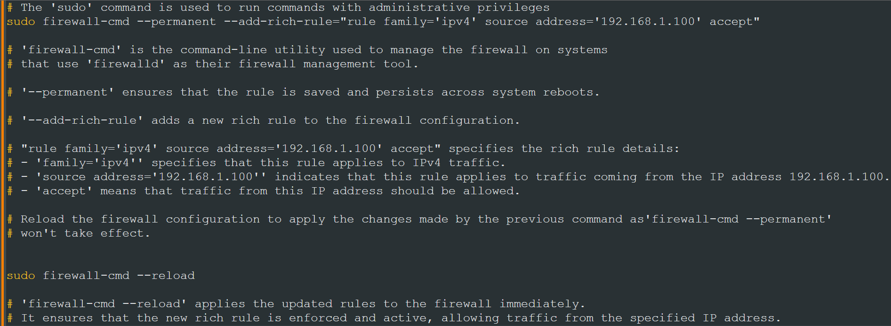
Allow specified IP Address

Slide 63
Allow specified IP Address

Slide 64
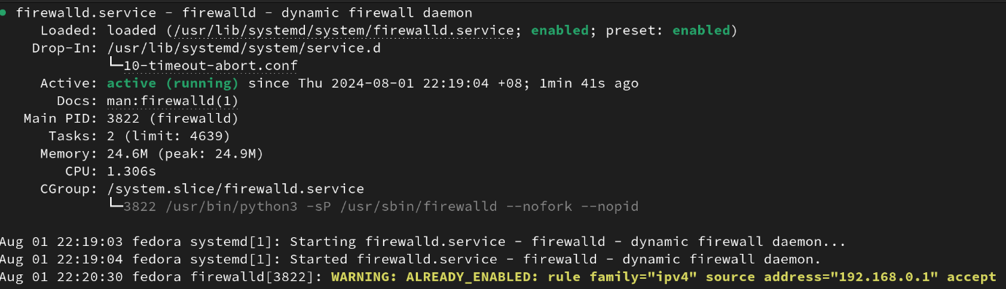
Allow specified IP Address
Allowed
result

Slide 65

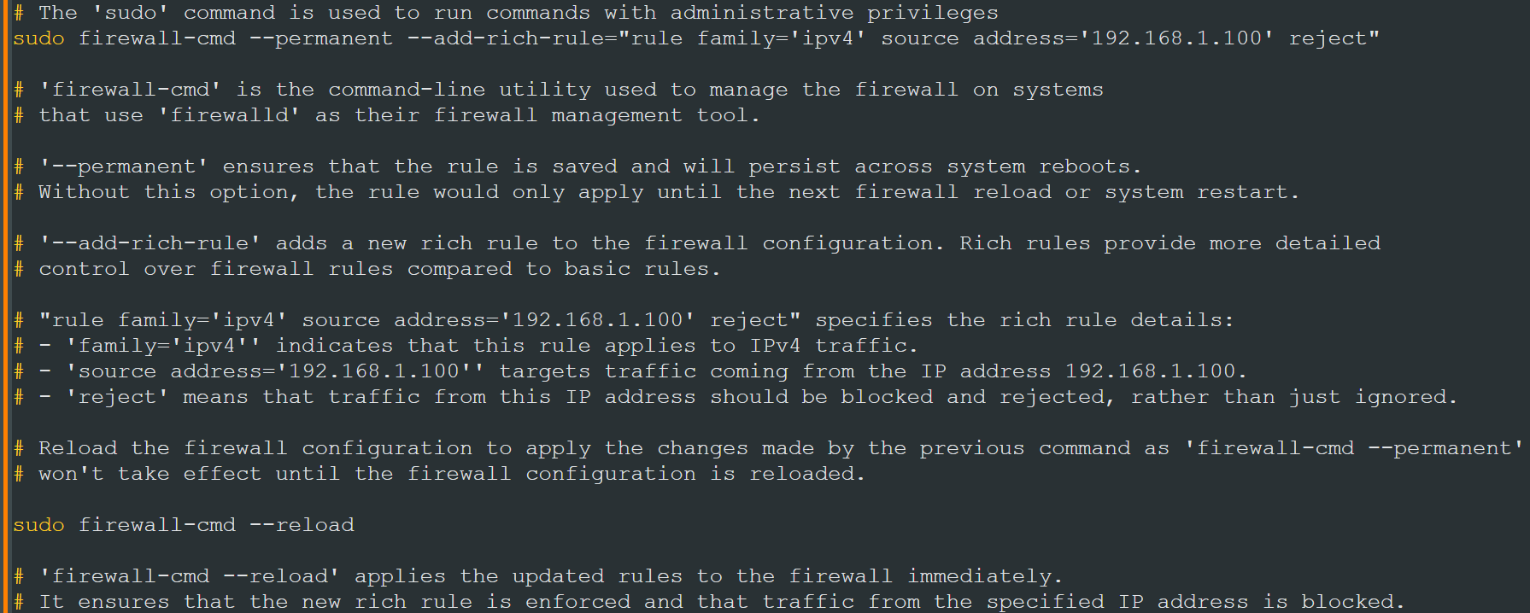
Reject specified IP Address

Slide 66
Reject specified IP Address

Slide 67
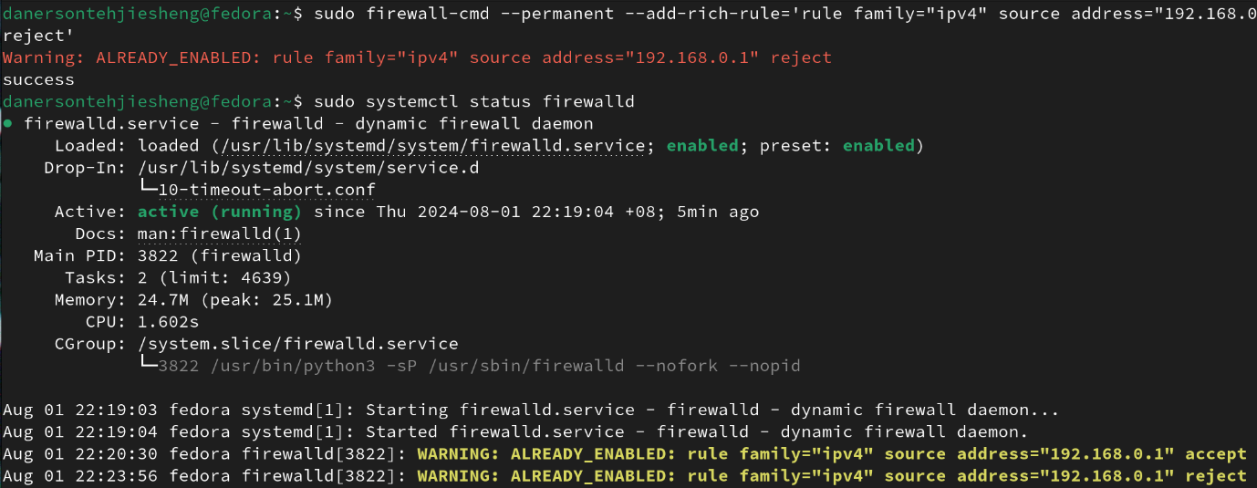
Reject specified IP Address
Rejected
result

Slide 68
mySQL configuration

Slide 69
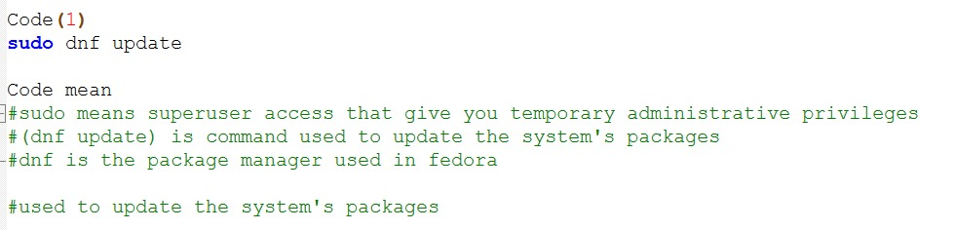
To setup mySQL in Fedora Linux,
Update the os service to the latest version

Slide 70
To setup mySQL in Fedora Linux,
Update the os service to the latest version

Slide 71
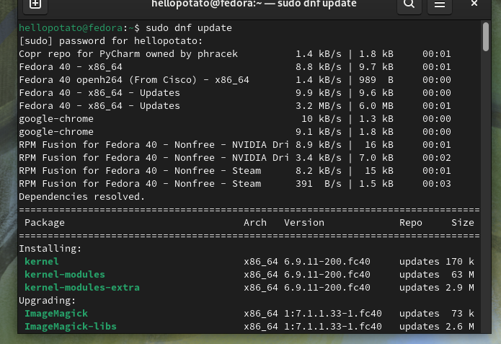
THE RESULT

Slide 72
After updated to latest version:
Install SQL server

Slide 73
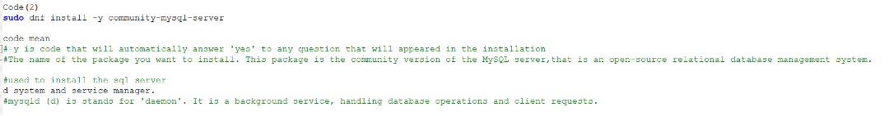
After updated to latest version:
Install SQL server

Slide 74
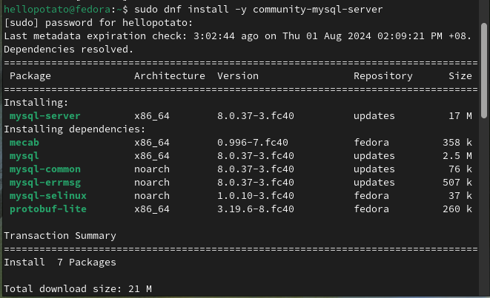
THE RESULT

Slide 75
Next

Slide 76
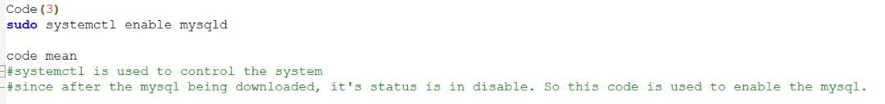
We have to enable the SQL

Slide 77
We have to enable the SQL

Slide 78
THE RESULT

Slide 79
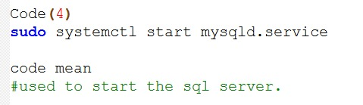
Then:
Start the SQL server

Slide 80
Then:
Start the SQL server

Slide 81
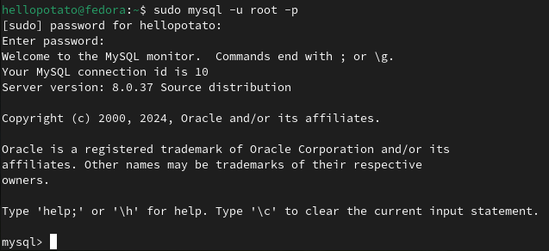
THE RESULT

Slide 82
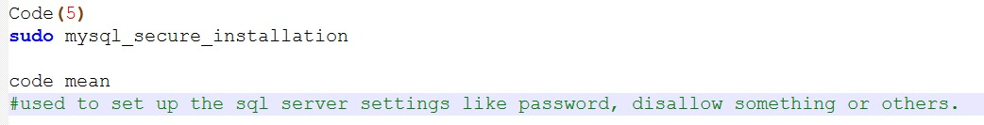
After server started:
Setting up the SQL server

Slide 83
After server started:
Setting up the SQL server

Slide 84

Yes, setting up password for SQL server access No, password-less access to SQL server

Slide 85

Choose whether allow user to login SQL server remotely
Choose whether access a blank database or with a test database
Choose whether reload or not reload your SQL server

Slide 86

After setting it up, we can now access into it
With this command

Slide 87
After setting it up, we can now access into it
With this command

Slide 88

FINAL RESULT

Slide 89
GIT configuration

Slide 90
To configure Git,
we need to install Git first

Slide 91

To install Git:

Slide 92

THE RESULT

Slide 93
After installing Git,
we can start configure it

Slide 94

Before upload your files/projects:
you must set your own identity
By using these commands

Slide 95
Before upload your files/projects:
you must set your own identity
If you didn’t do this:
By using these commands

Slide 96

If you didn’t do this:
This will happens

Slide 97
If you didn’t do this:
This will happen

Slide 98

additionally,

Slide 99
additionally,

Slide 100

Example:

Slide 101
To check Git status,

Slide 102
To check Git status,

Slide 103

result

Slide 104

To save the completed file into Git,

Slide 105

To save the completed file into Git,
result

Slide 106
To save the completed file into Git,
result

Slide 107
Now,
let’s try adding some different files

Slide 108


.png
txt
Html

Slide 109


result

Slide 110
To upload a file as version,

Slide 111

To upload a file as version,
result

Slide 112
To upload a file as version,
result

Slide 113

To check the version that has been uploaded,

Slide 114


To check the version that has been uploaded,
result

Slide 115
To check the version that has been uploaded,
result

Slide 116
To roll back/delete previous version,

Slide 117
To roll back/delete previous version,

Slide 118

result

Slide 119
For the github side,
we will need to have a github account and token to proceed

Slide 120




For the github side,
we will need to have a github account and token to proceed
2)
3)
1)
4)

Slide 121
Now, let’s try to interact between Linux and GitHub

Slide 122
Now, let’s try to interact between Linux and GitHub
Adding a Remote Repository
Updating the Remote Repository URL

Slide 123
Now,
we can upload the specify branch to remote repository,
or reversely with clone
By using this code

Slide 124
uploading specify branch to remote repository
By using this code

Slide 125

Result in Linux

Slide 126

Result in GitHub

Slide 127
Copy/clone specify branch from remote repository to local storage

Slide 128

Result in Terminal
*Note:
we’ve created a new file called “testtoclonefromgithub” on our local storage

Slide 129

Result in File System

Slide 130
If you meet any problems, please call our
snake head man:
017-7676 776
Or pm us at:
SHM7676@snakemail.com
V19 SHM
V10 SHM

Slide 131
THE END!

